Slide 1
Introduction to Python & Machine Learning
Presentation 1

Slide 2
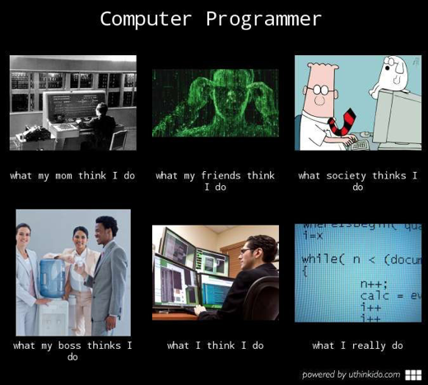

Slide 3
On Python
“Python is a truly wonderful language. When somebody comes up with a good idea it takes about 1 minute and five lines to program something that almost does what you want. Then it takes only an hour to extend the script to 300 lines, after which it still does almost what you want.”

Slide 4
Why Python?
1
Analytics
2
Automation
3
Accessibility
Python is the primary language for Machine Learning, Natural Language Processing, Robotics, etc.
The main advantage is that you can test hundreds of iterations very quickly. This is essential for exploration.
Python allows you to automate processes, scrape websites and work on unstructured data like text, images, audio, etc.
These are essential in creating a ‘Pipeline’ of processed information.
Python is easy to learn due to its readable syntax and simple approach to programming.
Within a year, you can begin producing industry standard code and conduct your own research.

Slide 5
How to access Python?
Command Line For very minor and small tasks.
Scripts and No-Hup For longer programs and mature applications. Can be automated to run regularly and on the server.
Jupyter Notebooks For iterative development and prototyping on the cloud or PC.

Slide 6
What all can you do with Python?
Data wrangling, processing and exploration. (Numpy, Pandas, PySpark)
Web Scraping, Browser Automation (Requests, Selenium)
Machine Learning (Sklearn, XGboost, PyTorch, Tensorflow)
Visualizations, Graphs (Matplotlib, Seaborn, Plotly)
Deploy apps or dashboards to the cloud (Heroku, Google Cloud)
Website development (Django, Flask, Pyramid)
Statistics and Econometrics (Statsmodels, scipy)
Robotics (Raspberry Pi)
Text Mining (nltk, gensim, spacy)
Image Processing (Pillow, OpenCV)
Optimization Problems (PuLP, Pyomo)

Slide 7

Quiz 1: Python Syntax
Log on to www.kahoot.it on your mobile devices.

Slide 8

Quiz 2: Pandas Syntax
Log on to www.kahoot.it on your mobile devices.

Slide 9
Essential Packages for Data Science
Pandas For general data handling and exploration.
Numpy The ‘Matlab’ within Python, for working on N-dimensional arrays.
Sklearn For basic analytical algorithms.
Matplotlib For plots, histograms and charts.

Slide 10
A year long road map.
Do the basic Python tutorials on Programiz, Code Academy. (2 weeks)
Do tutorials on the essential packages - Pandas, Numpy, Sklearn, Matplotlib. (1 month)
Enroll into the starter Kaggle Competitions. (1 month)
Begin formal courses - Andrew Ng’s Machine Learning on Coursera, etc. NPTEL Videos, Data Camp, etc. (2-3 Months)
Read articles from Analytics Vidhya, KDnuggets, etc. (1 Month)
Open a github repo - start working on small sized project. (4-5 Months)
Try to reading classic ML papers, take on harder courses on Text and Image processing. PyTorch/Tensorflow/XGboost. (7-8 Months)
Build a complete ML Pipeline either at work or elsewhere (1 year)

